Slide 1
How to deliver a Microsoft Cloud Workshop
Notes:
Welcome to “How to deliver a Microsoft Cloud Workshop.”

Slide 2

Contents
Format of whiteboard design sessions and hands-on labs
Whiteboard design session walk-through Whiteboard design session artifacts
Hands-on lab (HOL) walk-through
Hands-on lab (HOL) artifacts
Notes:
A Microsoft Cloud Workshop (or MCW) is composed of a whiteboard design session, a hands-on lab, and other briefings you choose to bring into an event. Here, we will review how to run both a whiteboard session and a hands-on lab, and also share artifacts that help support your delivery.

Slide 3
The whiteboard design session format
The whiteboard design session format
These technical sessions are distinct from other learning experiences.
Share, investigate, and learn from others: Workshops provide a safe space for attendees to share, investigate, and learn from others as they apply their knowledge.
Workshop experience: Small groups, with the help of a proctor, prepare designs and deployment plans that they present to other groups.
Open laptop: Internet available for attendees to conduct research.
Case studies: Sessions explore problems based on case studies designed in collaboration with engineering and top field sales teams.
Notes:
The whiteboard design session format is different than breakouts and other forms of training, such as hands-on labs. They are intended as workshops that give attendees an opportunity and a safe place to share, investigate, and learn from others as they apply their knowledge. These interactive learning experiences are conducted in small groups where attendees prepare presentations, designs, and deployment plans to share with their table. Internet will be available for attendees to research details as needed. The problems attendees are trying to solve are based off of case studies that have been designed in collaboration with our Engineering and top field sales teams.

Slide 4
Whiteboard design session walk-through
Whiteboard design session walk-through
Step 1: Review the customer case study (15 min)
Analyze your customer’s needs.
Outcome Know the…
Customer’s background, situation, needs, and technical requirements
Current customer infrastructure and architecture
Potential issues, objections, and blockers
Notes:
There are four steps we’ll walk through during a whiteboard design session.
The first step is to review the customer case study. Here you’ll cover the customer’s situation, requirements, and current architecture, as well as potential issues or objections they may have.

Slide 5
Whiteboard design session walk-through
Whiteboard design session walk-through
Step 2: Design a solution (60 min)
Determine your target customer audience.
Determine customer’s business needs to address with your solution.
Design the solution.
Prepare to present your solution.
Outcome
Be ready to present a solution for your target customer audience.
Notes:
Step 2 is to design a solution. Attendee teams will design an appropriate solution based on the customer needs, current infrastructure, and blockers, as they prepare a solution to present.

Slide 6
Whiteboard design session walk-through
Whiteboard design session walk-through
Step 3: Present the solution (30 min)
Pair up attendee teams.
Each team presents their solution.
Teams respond to customer objections.
Facilitator and other attendee teams provide feedback.
Outcome
Practice presenting to customers, explaining decisions, and handling objections.
Notes:
Step 3 is to present the solution. Attendee teams pair up with another table to present their solutions to each other. During the presentations, be prepared to ask questions and encourage other attendees to raise questions and objections. This will help teams practice responding to customer objections. Also, make sure that teams have time to provide each other with feedback.

Slide 7
Whiteboard design session walk-through
Whiteboard design session walk-through
Step 4: Wrap-up (15 min)
Come back together as a large group. Review preferred solution.
Address questions and provide further resources.
Outcome
Attendees debrief experience, reflect on their work, and discuss preferred solution.
Notes:
Step 4 is the wrap-up. This is where you will go over the preferred solution. It is also a time to answer questions and provide further resources.

Slide 8
Whiteboard design session artifacts
Whiteboard design session artifacts
Artifacts are available to help you facilitate design sessions.
Student Guide: Includes case study scenario and questions.
Share a copy with all attendees.
Trainer Guide: Includes thorough answers to all questions posted in Student Guide. Review ahead of time and share with only proctors before an event. Share with attendees after an event as reference materials.
Presentation Deck: Slides that introduce the whiteboard design session and concludes with the present-back on the preferred scenario.
Notes:
Artifacts are available to help you facilitate the design session. First, a student guide can be shared with all attendees to review the case study scenario and questions. The Trainer guide is given to proctors prior to the event, and then provided to all attendees after the event as a useful reference. The trainer presentation deck is used to introduce the whiteboard design session as well as to present back the preferred solution.

Slide 9
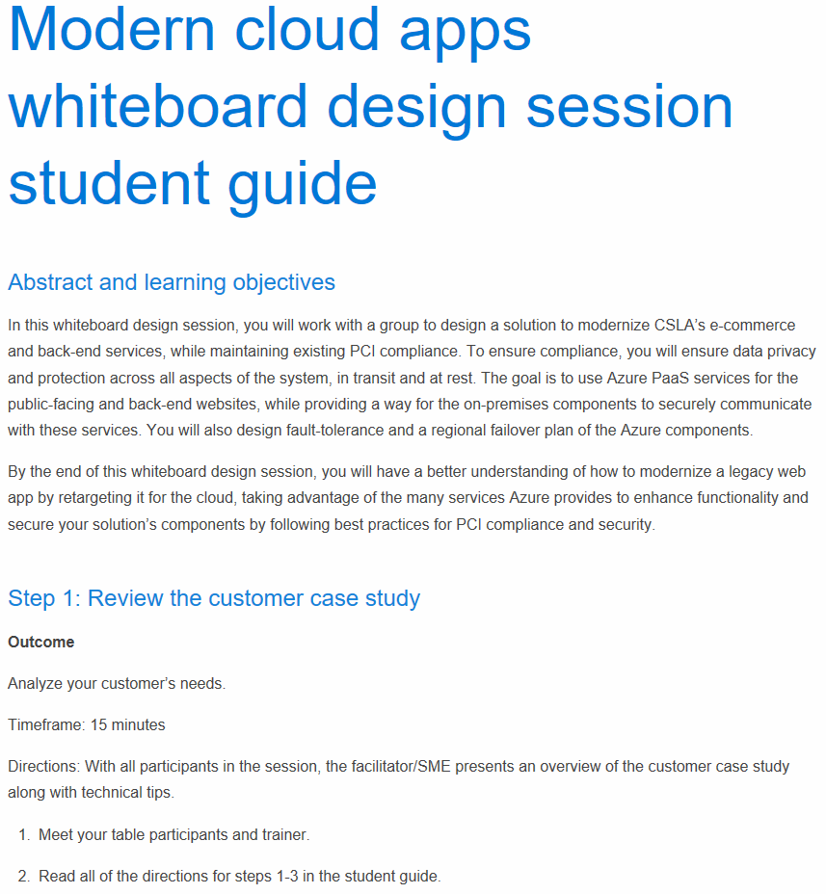
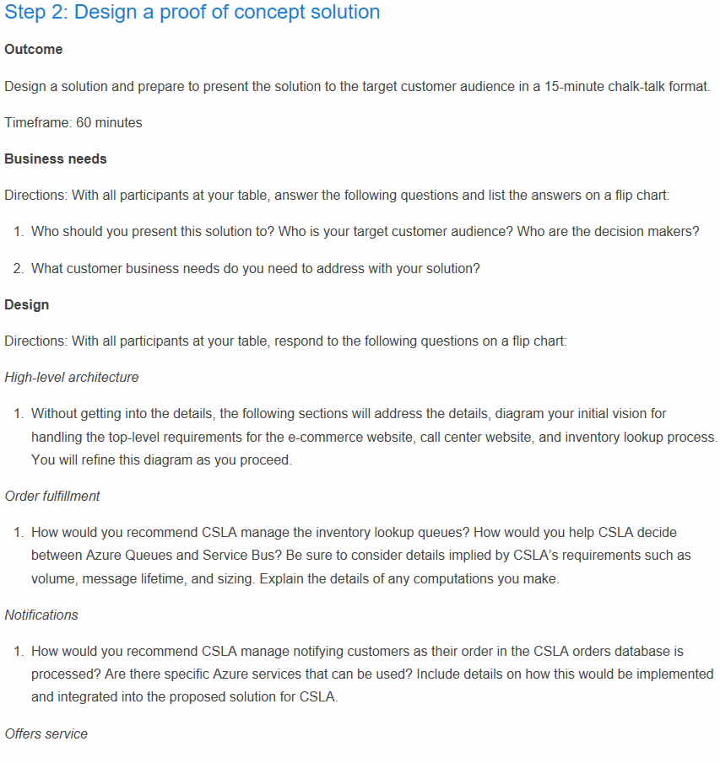
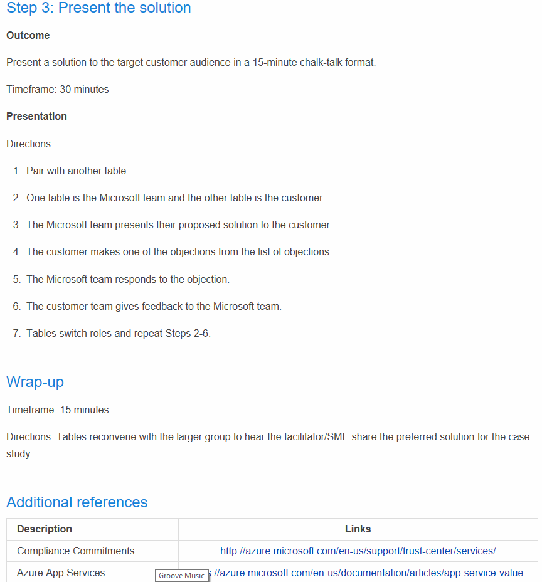
Sample of student guide
Sample of student guide
Sample student guide
Share with all attendees using HTML link.
Notes:
Here is a sample of the Student Guide. You will provide an HTML link to share this with attendees, so that there is no direct access to the GitHub page. Students should not have access to the Markdown file.
The Student Guide contains the customer situation, list of business needs, and customer objections. Don’t forget to use the list of references at the end of the document. These references help inform the elements of the preferred solution and provide links to resource details.

Slide 10
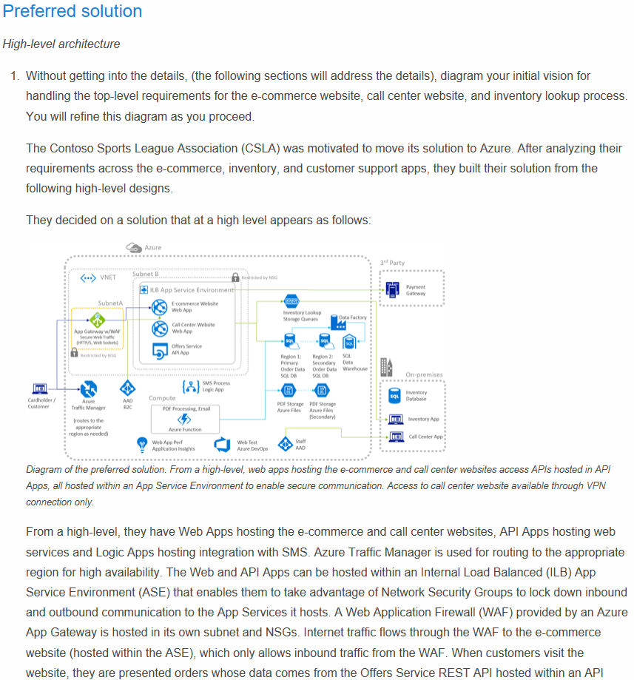
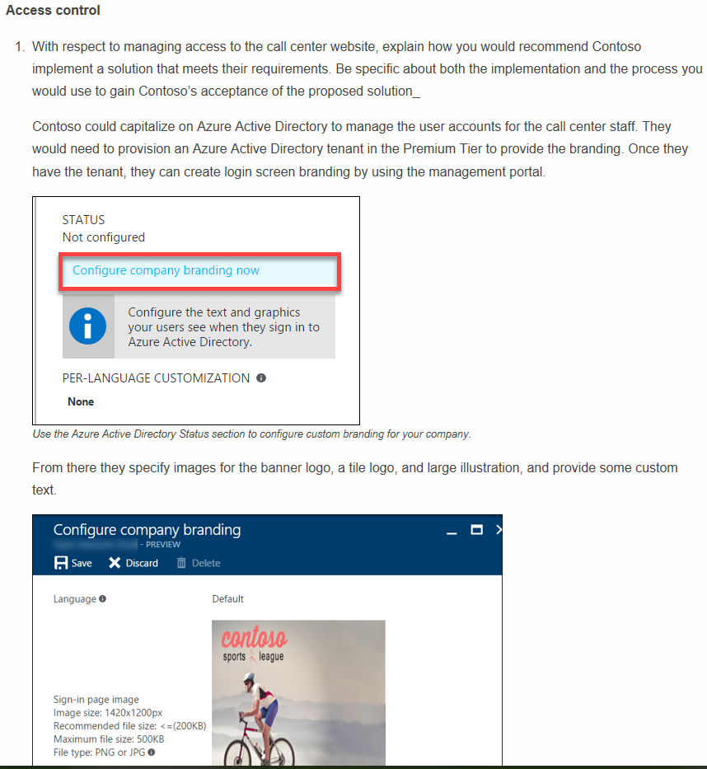
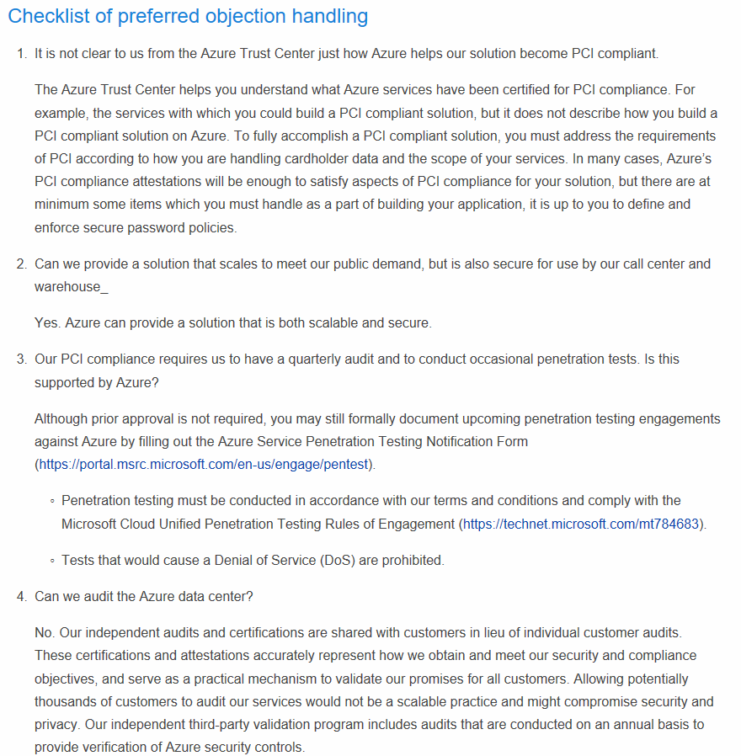
Sample of trainer guide
Sample of trainer guide
Sample trainer guide
Notes:
The trainer guide contains a high-level diagram of the preferred solution, details for addressing the customer’s needs, and answers to their objections. It ends with a fun quote from the customer.

Slide 11
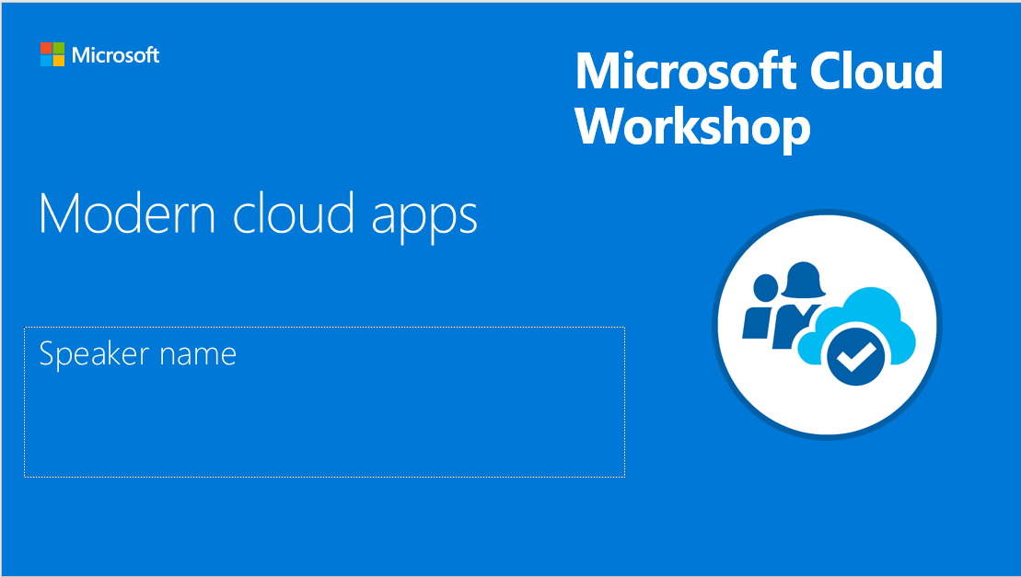
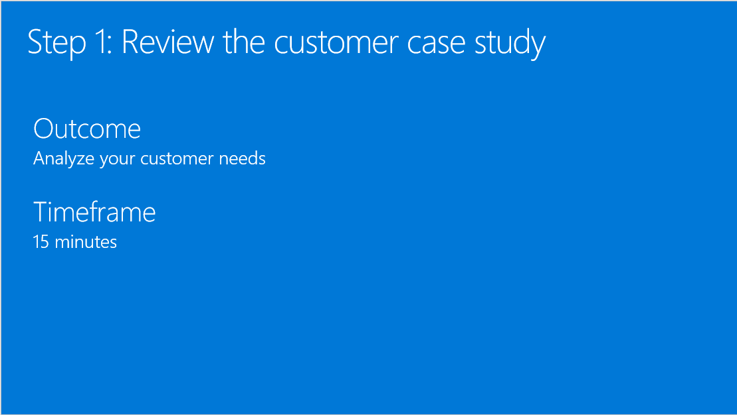
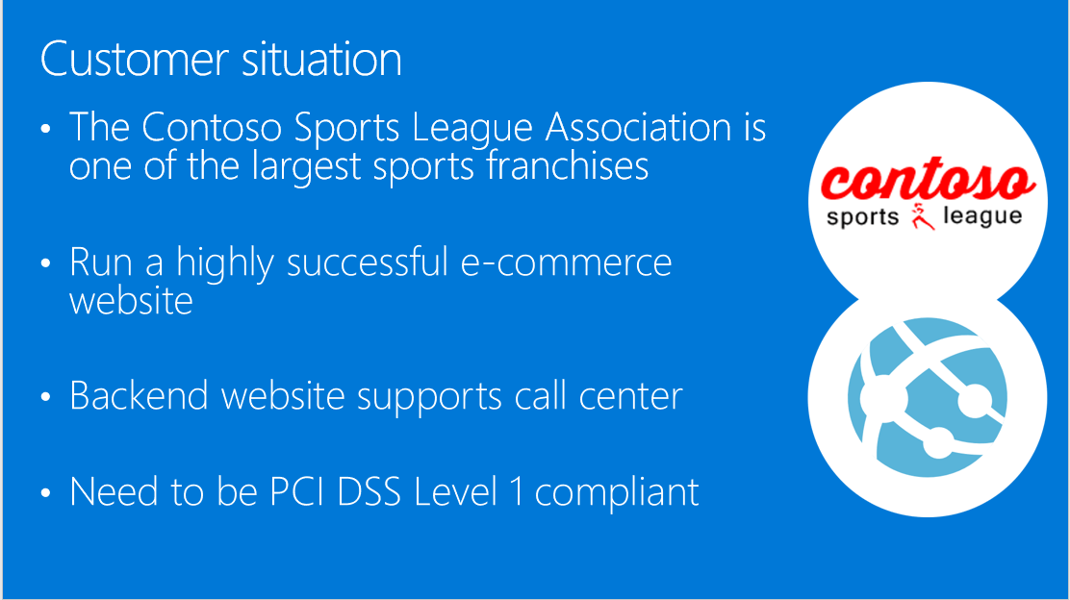
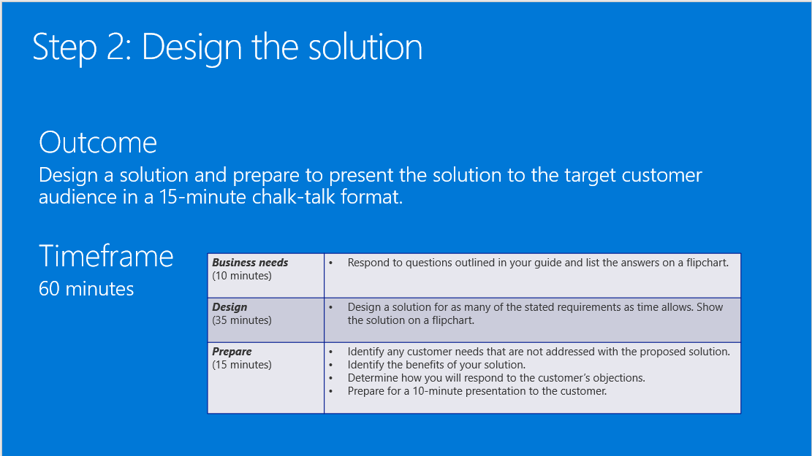
Presentation deck: Beginning a session
Presentation deck: Beginning a session
Notes:
Here’s a sample of what is presented at the start of each whiteboard design session. Use this deck to present the content, not the Github page. This deck can be downloaded from the Github branch ahead of time. It frames the customer situation, including technical needs and issues, and then outlines the tasks for the attendees to compete.

Slide 12
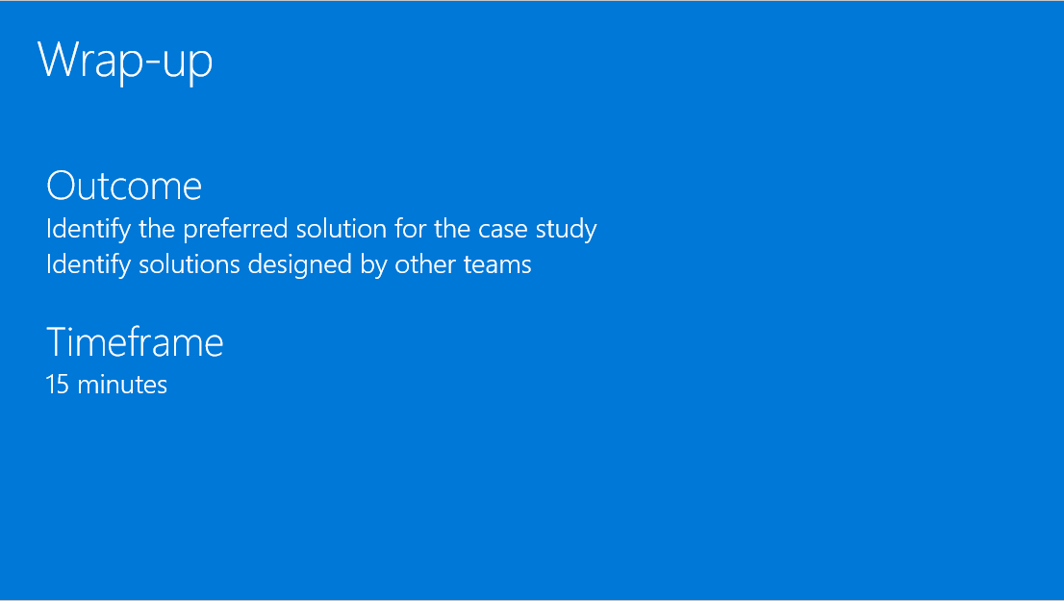
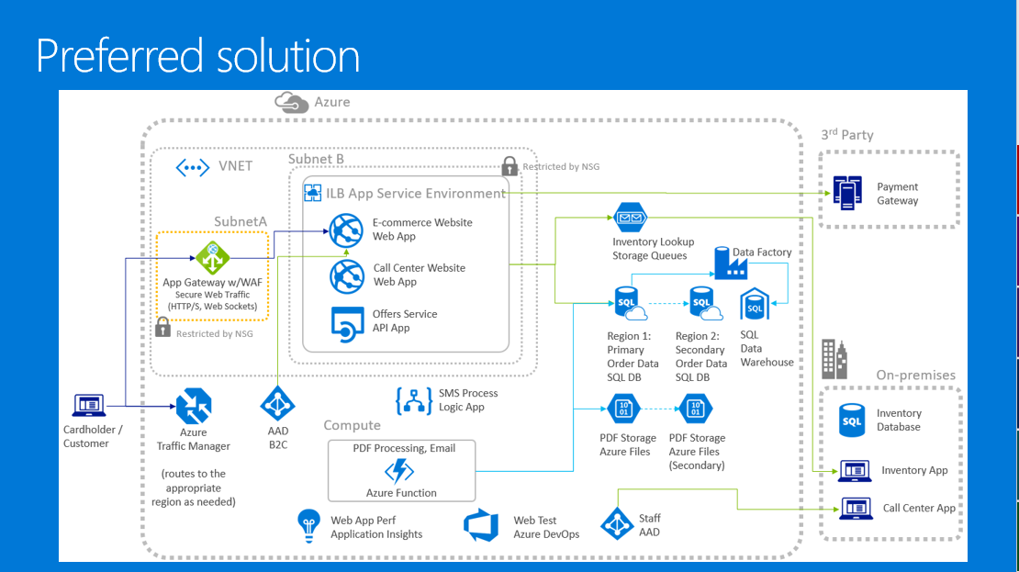
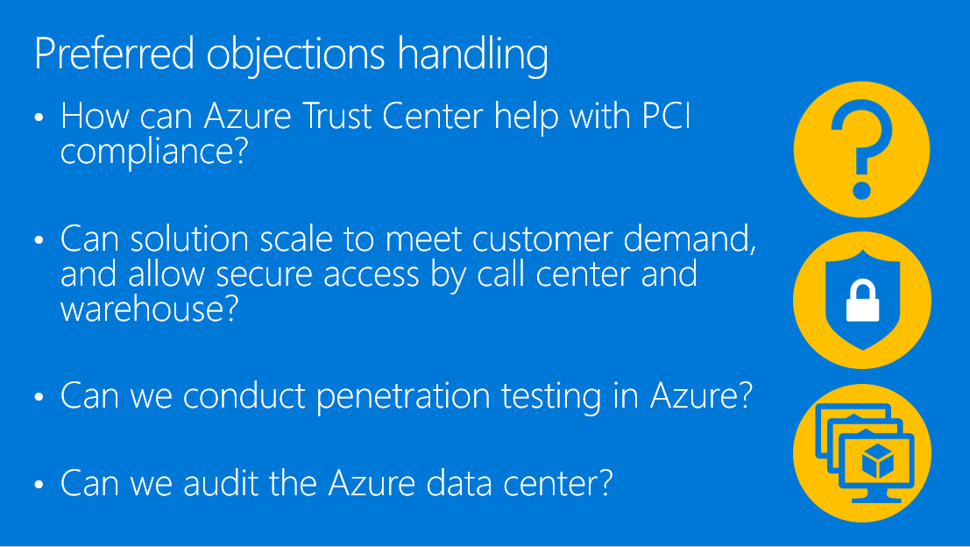
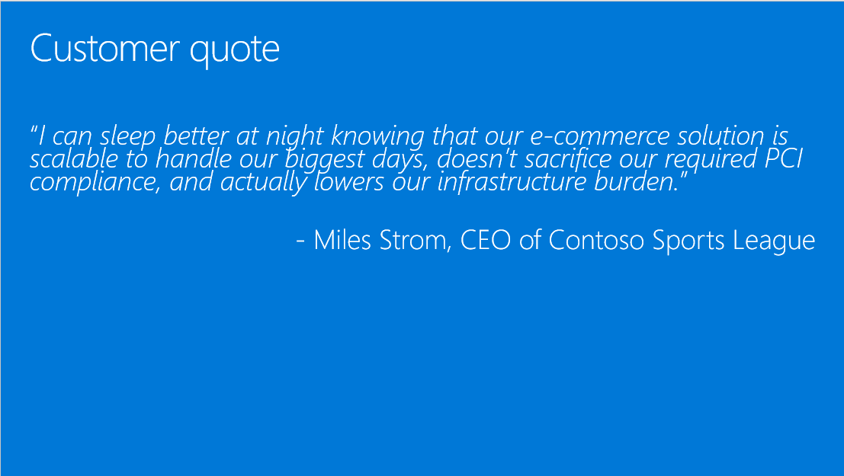
Presentation deck: Ending a session
Presentation deck: Ending a session
Notes:
At the end of each whiteboard design session, the trainer presentation deck will display the high-level architecture of the preferred solution, and walk through the solution details and objections handling. Finally, it will end with the customer quote.

Slide 13
How to do a present-back
How to do a present-back
Do not just read the slides.
Be familiar with the solution deck content
Focus on the key details on each slide
Augment with your own experiences
If applicable, address the alternate solutions proposed by attendees at the tables you monitored.
Decide ahead of time if you will take questions. If so, make sure you stay on time and set expectations to save questions for the end. Alternatively, you can take questions offline after the session.
Notes:
When presenting back the solution, focus on the key details of each slide and add in your own experiences when you can. Do not just read the slides. Your personal reflections and anecdotes help liven up the content and presentation. If you saw some interesting solutions when walking around the tables, you may also choose to point them out as alternatives to the preferred solution. Remember, there are many ways to solve the problem. Some attendees might have come up with some novel ways to do so. If you decide that you will take questions, make sure you stay on time and set expectations to save questions for the end.

Slide 14
Hands-on lab details
Notes:
Next, we will review details for hands-on labs.

Slide 15
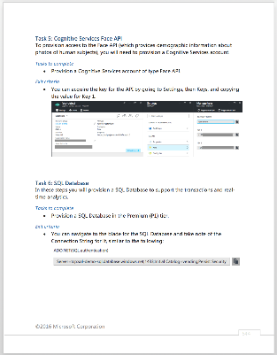
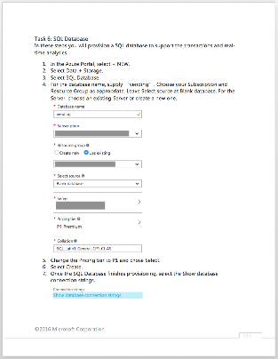
Hands-on lab (HOL) artifacts
Hands-on lab (HOL) artifacts
Two artifacts available for hands-on labs
Before-the-HOL Guide
A step-by-step guide on how to provision the lab environment before the lab is performed.
Step-by-step Hands-on Lab Guide
A step-by-step guide to completing the hands-on lab, this piece includes thorough steps and screenshots to all tasks posed in the hands-on lab.
Notes:
There are two artifacts for each hands-on lab: The “before the hands-on lab” guide and the “step-by-step” guide. The “Before the hands-on lab” guide can be distributed before the class or performed during the class time. If done during the class time, make sure to account for that in your schedule planning. The hands-on lab guide includes the step-by-steps as well as screenshots for all the tasks. These documents should also be distributed by HTML link, and, again, the students should not have access to the markdown files.

Slide 16
Hands-on lab walk-through
Hands-on lab walk-through
Perform the hands-on lab (4 hours)
Proctors should be available in the room to help with questions.
Hands-on labs are intended for completion in three to four hours.
Remind attendees to delete any Azure resources they provisioned for the hands-on lab upon completion.
Outcome
Attendees practice and apply technical skills as they complete the hands-on lab.
Notes:
Each hands-on lab is timed at roughly four hours to complete. Proctors should be available to help with questions or issues. Although each hands-on lab concludes with an Azure resource cleanup step, make sure the attendees remember to delete the resources, so they don’t get hit with excessive fees.
Thank you, and remember to have fun.

